Slide 1



BMS
Institute of Technology and Management
Module – 5
Trees and its properties
18CS36
By,
Dr. Pushpa S. K
Professor
Dept. of Information Science & Engg.
BMS Institute of Technology & Mgmt. Bengaluru.
Department of Information Science & Engineering

Slide 2
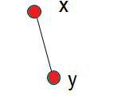
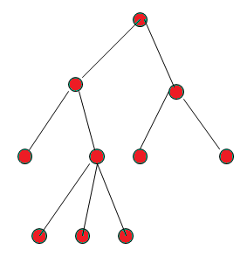
Introduction
A tree is a connected simple undirected graph with no cycles.
A forest is a disconnected trees with no cycles.
(Note: If n – vertices, m – edges, in Forest F, then n = m+k, where k – No. of components)
X is the parent of Y

Slide 3
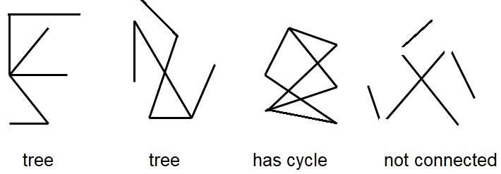

Slide 4
Theorem1
An undirected graph is a tree iff there is a unique simple path b/t any two of its vertices. Or
If a, b are distinct vertices in a tree, then there is a unique path that connects these vertices.
Proof:”=>”: T: any tree; x,y: two distinct vertices.
Since T is connected, by definition., there is a path and hence a simple path a from x to y. Assume there is another simple path b from x to y.
There is a simple circuit in T.=> T is not a tree, a contradiction!
But T has no cycle. Hence Proof.

Slide 5
Theorem2
A tree with n vertices has n−1 edges
Proof: We prove the result by using induction on n, the number of vertices. The result is obviously true for n = 1, 2 and 3. Let the result be true for all trees with fewer than n vertices.
Let T be a tree with n vertices and let e be an edge with end vertices u and v. So the only path between u and v is e. Therefore deletion of e from T disconnects T.
Now, T − e consists of exactly two components T1 and T2 say, and as there were no cycles to begin with, each component is a tree.

Slide 6
Let n1 and n2 be the number of vertices in T1 and T2
respectively,
so that n1 + n2 = n. Also, n1 < n and n2 < n.
Thus, by induction hypothesis,
number of edges in T1 and T2 are respectively n1 −1 and n2 −1. Hence the number of edges
in T = n1 −1+n2 −1+1
= n1 +n2 −1
= n−1.

Slide 7
Theorem 2
Theorem: A tree with n nodes has n – 1 edges.
Using Rooted Tree : Pick a vertex u in the tree and make u the root. Each edge now links a parent and a child. The root has no parent, but every other node has exactly one parent # of edges = n – 1

Slide 8
Theorem2
Any connected graph with n vertices and n−1 edges is a tree.
Proof: Let G be a connected graph with n vertices and n − 1 edges. We show that G contains no cycles.
Assume to the contrary that G contains cycles.
Remove an edge from a cycle so that the resulting graph is again connected.
Continue this process of removing one edge from one cycle at a time till the resulting graph H is a tree.
As H has n vertices, so number of edges in H is n−1.
Now, the number of edges in G is greater than the number of edges in H. So n−1 > n−1, which is not possible. Hence, G has no cycles and therefore is a tree.

Slide 9
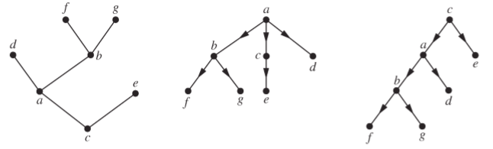
Rooted Tree
A rooted tree, is a pair (T,r) where T = (V,E) is a tree, and r ∈V is a chosen root vertex of the tree. Often, the edges of a rooted tree (T,r) are viewed as being directed, such that for every vertex v the unique path from r to v is directed away from (or towards) r.

Slide 10
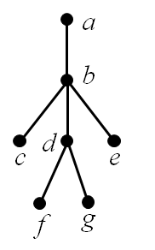
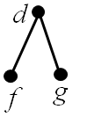
a is the parent of b, b is the child of a, c, d, e are siblings, a, b, d are ancestors of f c, d, e, f, g are descendants of b c, e, f, g are leaves of the tree
(deg=1) a, b, d are internal vertices of the tree (at least one child) subtree with d as its root:

Slide 11
Theorem3
For every tree T =<V, E> if |V|>=2, then T has at least two pendant vertices.
1
2 3
4
5 6
2|E| = Total Degree, 2|5| = 10.
2(6-1) = 2(n-1) = 2(5) = 10. where n = no. of vertices.

Slide 12
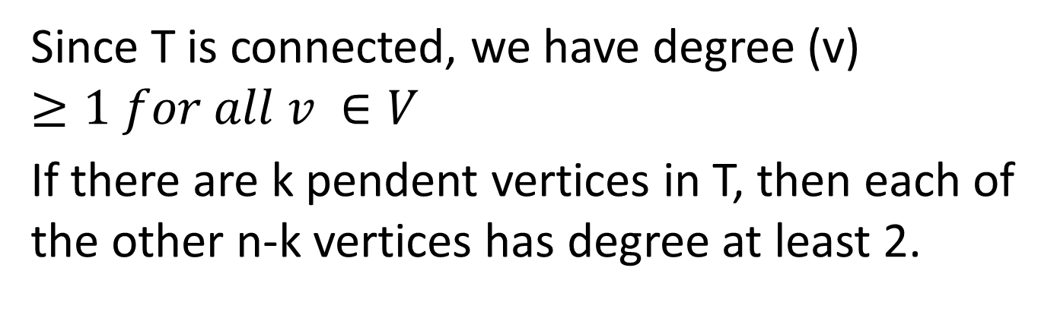
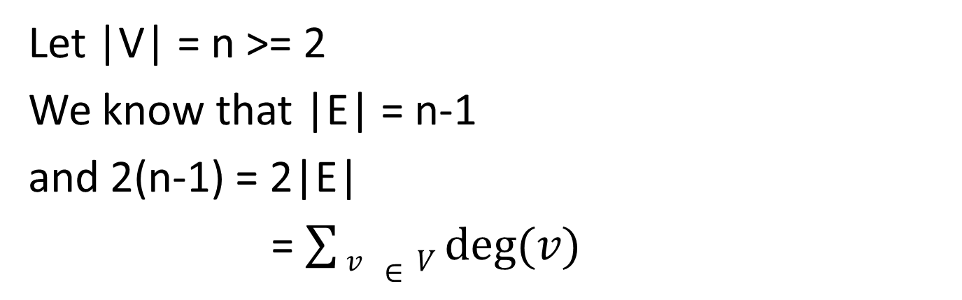
Let |V| = n >= 2
We know that |E| = n-1
and 2(n-1) = 2|E|
= $\sum{v ∈V deg⁡(v)}$
Since T is connected, we have degree (v) $≥1 for all v ∈V$
If there are k pendent vertices in T, then each of the other n-k vertices has degree at least 2.

Slide 13
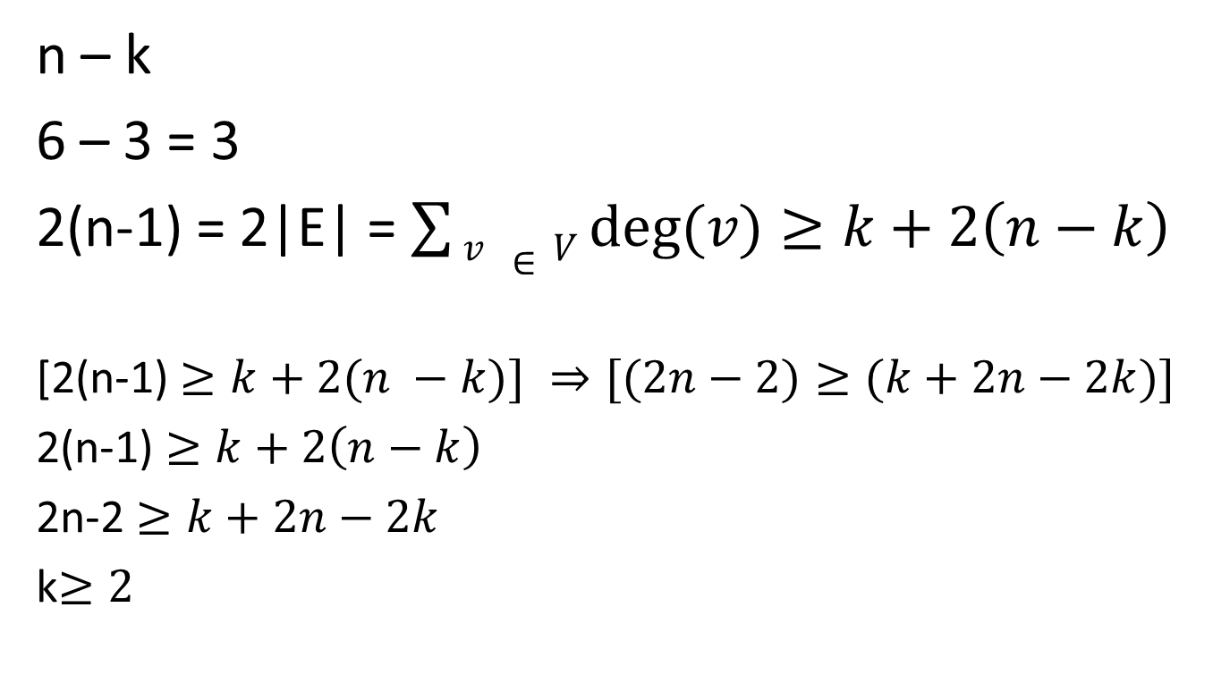
n – k
6 – 3 = 3
2(n-1) = 2|E| = $\sum{v ∈V deg⁡(v)}≥k+2\left(n−k\right)$
[2(n-1) $≥k+2(n −k)] ⇒[(2n−2)≥(k+2n−2k)]$
2(n-1) $≥k+2\left(n−k\right)$
2n-2 $≥k+2n−2k$
k$≥2$

Slide 14
Theorem3
Any tree with at least two vertices has at least two pendant vertices
Proof Let the number of vertices in a given tree T be n(n > 1). So the number of edges in T is n−1. Therefore the degree sum of the tree is 2(n−1). This degree sum is to be divided among the n vertices. Since a tree is connected it cannot have a vertex of 0 degree. Each vertex contributes at least 1 to the above sum. Thus there must be at least two vertices of degree exactly 1.

Slide 15
Spanning Trees
Graph G1 contains all the vertices of G2 and G1 is a tree. G1 is the spanning tree of G2. Hence a spanning tree for a connected graph is a spanning subgraph that is also a tree.
G2
G1

Slide 16
Theorem 4
If G = <V, E> is an undirected graph, then G is connected if and only if G has a spanning tree.
Proof: If G has a spanning tree T, then for every pair a,b of distinct vertices in V a subset of the edges in T provides a path between a and b, and so G is connected.

Slide 17
Conversely:
If G is connected and G is not a tree remove all loops from G.
If the resulting subgraph G1 is not a tree, then G1 must contain a cycle C1
Remove an edge e1 from C1 and let G2 = G1 – e1
If G2 contains no cycles, then G2 is a spanning tree for G because G2 contains all the vertices in G, is loop free and is connected.

Slide 18
If G2 does contain a cycle – say C2 – then remove an edge e2 from C2 and consider the graph G3 = G2 –e2. i.e G1 – { e1, e2}.
Once again, if G3 contains no cycles, then we have a spanning tree of G.
Otherwise we continue this procedure a finite number of additional times until we arrive at a spanning subgraph of G i.e loop free and connected and contains no cycles.

Slide 19
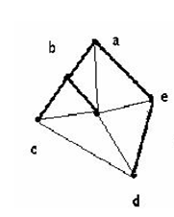
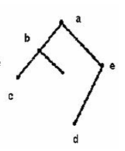

Slide 20
How many edges must be removed from a connected graph with ‘n’ vertices and ‘m’ edges to produce a spanning tree?
m = edges = 5
n = vertices = 10
We have m-n + 1 = 5 -10 + 1 = 4 edges

Slide 21
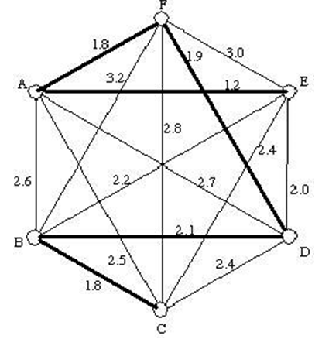
Given a weighted graph G, a minimum spanning tree is
a spanning tree of G
that has minimum “weight

Slide 22
Theorem5
In every tree T = <V, E> = |E| + 1 =|V|
Proof: by mathematical induction to |E|
If |E| = 0, then the tree consists of a single isolated vertex.
Hence we know that |V| =|E| + 1
From the figure: V = 1+1 =2
V = 2+ 1 =3
Hence it is true for E=0, E=1, E=2

Slide 23
Theorem5
Inductive Clause:
Assume that theorem is true for every tree that contains at most K edges, where K>=0.
Now consider a tree T = <V, E>, Where |E| = K+1
If for instance, the edges with end points
X Y
If for instance , the edge with end points
X, Y is removed from T, we obtain two
Subtrees
T1 = <V1, E1> and T2 = <V2, E2>
Where |v| = |v1| + |v2| and |E1| +|E2| + 1

Slide 24
By induction hypothesis,
|Ei| + 1= Vi for, I = 1, 2
|v| = |v1| + |v2|
= |E1 + 1| + |E2 +1|
= (|E1| + |E2| + 1) + 1
= |E| + 1 X Y
Hence by mathematical induction it is true
for |E| = K+1

Slide 25
Problem
(1)Let T1=<V1,E1> and T2=<V2, E2> be two trees where |E1| = 17 and |V2| = 2|V1|. Then find |V1|, |V2| and |E2|
(2) Let F2 =<V2, E2> is a forest with |V2| = 62 and |E2| = 51. How many trees determine F2
(3) Let F1 = <V1, E1> be a forest of 7 trees where |E1| = 40 what is |V1| ?

Slide 26
Solution
Given |E1| = 17
We know that |V| = |E| + 1
|V1| = |E1| + 1
= 17 + 1 = 18
Given |V2| = 2. |V1|
= 2. 18
= 36
Then , |E2| = |V2| - 1 |V2| = |E2| +1
|E2| = 36 – 1 |V2| -1 = |E2|
= 35

Slide 27
2. Let F be a forest with K components (trees)
If n is the number of vertices and m is the number of edges in F,
Then, n= m+k
|V| = |E| + K
Here |V2| = 62 , |E2| = 51
|V2| = |E2| +K
62 = 51 + K
K = 11

Slide 28
3) K = 7, |E1| = 40
|V1| = |E1| + K
|V1| = 40 + 7
|V1| = 47

Slide 29
Binary Tree
0
1
2
3
# of leaf nodes = 2^{h} =1 + 2+ 4+ 8 + ……
# of nodes = 2^{h+1}- 1
Height of a complete binary tree is = log₂n

Slide 30
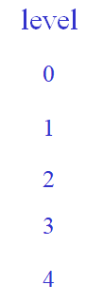
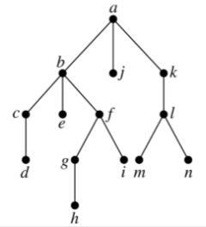
Height of m-ary tree
Def: The level of a vertex v in a rooted tree is the length of the unique path from the root to this vertex. The level of the root is defined to be zero. The height of a rooted tree is the maximum of the levels of vertices.
height = 4

Slide 31
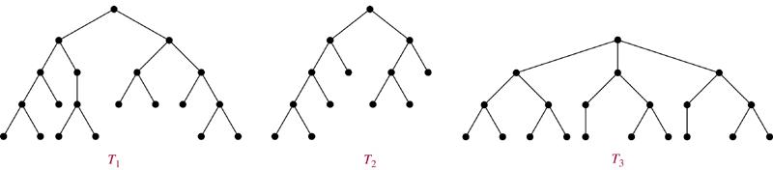
m-ary tree
Def: A rooted m-ary tree of height h is balanced if all leaves are at levels h or h−1.
Sol. T₁, T₃

Slide 32
m-ary tree
Definition: A complete m-ary tree is a full m-ary tree, where every leaf is at the same level.
How many vertices and how many leaves does a complete m-ary tree of height h have?
Solution
# of vertices = 1+m+m²+…+m^{h} = (m^{h+1}−1)/(m−1)
# of leaves = m^{h}

Slide 33
Theorem 6
A full m – ary tree with ‘i’ internal vertices contains n = m* i +1 vertices.
Proof:
Every vertex (except root) is the child of an internal vertex
Each of the i internal vertices has m children
There are m* i vertices ( other than the root)
Therefore n= m*i +1 vertices.

Slide 34
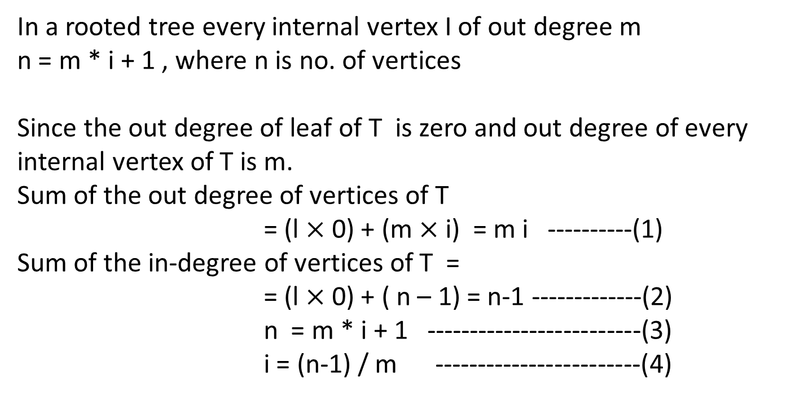
In a rooted tree every internal vertex I of out degree m
n = m * i + 1 , where n is no. of vertices
Since the out degree of leaf of T is zero and out degree of every internal vertex of T is m.
Sum of the out degree of vertices of T
= (l $×$ 0) + (m $×$i) = m i ----------(1)
Sum of the in-degree of vertices of T =
= (l $×$ 0) + ( n – 1) = n-1 -------------(2)
n = m * i + 1 -------------------------(3)
i = (n-1) / m ------------------------(4)

Slide 35
Using (3) & (4)
i * m + 1 = l + I
l = (m-1) i + 1 -------------------------------------(6)
i= (l-1) / (m-1) -----------------------------------(7)
Substituting (7) in (1) we get
n = 1 + (l -1)/(m-1) or (m-1) n = l(m-1) +1-1 = lm -1
l = [(m-1) n +1] / m

Slide 36
Properties
A full m-ary tree with
n vertices has i =(n-1) /m
i internal vertices has n= m*i +1 vertices and l = (m-1) i +1 leaves
l leaves has n = (ml -1) / (m -1) vertices and i = (l - 1) / (m-1) internal vertices.

Slide 37
Applications
Binary Search Tree
Decision tree
Weighted Trees and Prefix Code
Huffman Coding
Tree Traversal
Merge Sort
Spanning Tree

Slide 38
Binary Search Trees
Binary Search Tree: Binary tree + each child of a vertex is designed as a right or left child, and each vertex v is labeled with a key label(v), which is one of the items.
Note: label(v) > label(w) if w is in the left subtree of v and label(v) < label(w) if w is in the right subtree of v

Slide 39
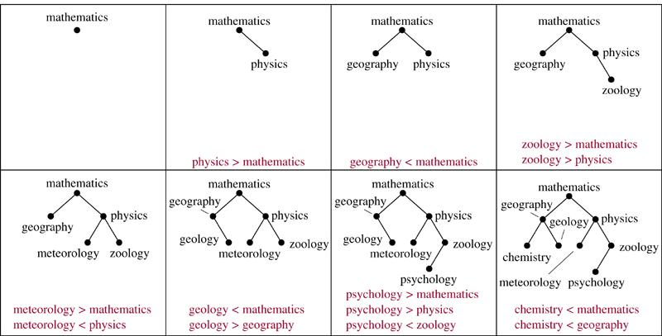
Example 1 Form a binary search tree for the words mathematics, physics, geography, zoology, meteorology, geology, psychology, and chemistry (using alphabetical order).
Sol.

Slide 40
Example 2 Use Algorithm 1 to insert the word oceanography into the binary search tree in Example 1.
label(v) = mathematics < oceanography
Sol.
mathematics
label(v) = physics > oceanography
v
label(v) = meteorology < oceanography
geography
physics
meteorology
zoology
chemistry
geology
oceanography
psychology

Slide 41
Decision Trees
A rooted tree in which each internal vertex corresponds to a decision, with a subtree at these vertices for each possible outcome of the decision, is called a decision tree.
Many important algorithms, like sorting and searching work by comparing items of their inputs. One can study the performance of algorithms with a device called the decision tree.

Slide 42
Example 3 Suppose there are seven coins, all with the same weight, and a counterfeit coin that weights less than the others. How many weighings are necessary using a balance scale to determine which of the eight coins is the counterfeit one? Give an algorithm for finding this counterfeit coin.

Slide 43
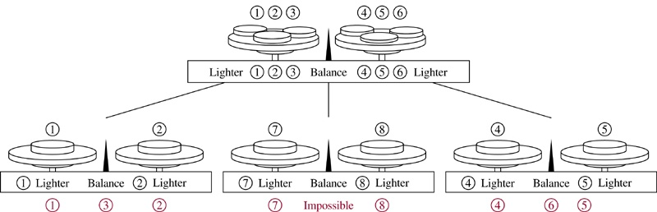
Sol.
When weighing, it is either the two pans can have equal weight or the first pan can be heavier, or the second pan can be heavier ⇒ 3-ary tree
Need 8 leaves ⇒ Need to weigh at least twice

Slide 44
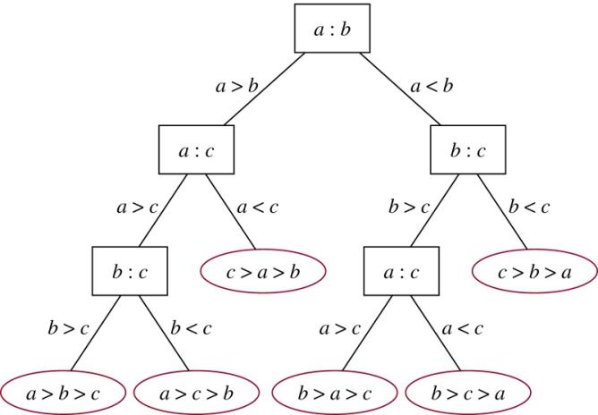
Example 4 A decision tree that orders the elements of the list a, b, c.
Sol.

Slide 45
Weighted Trees and Prefix Code
Data compression is an important technique for saving storage space.
Given a file which we consider as a string of characters, we want to find a compressed file as small as possible, such that the original file can be reconstructed from the information in the compressed file.
There are two ways of encoding
Fixed length code
Variable length code

Slide 46
If we use a fixed length code, we need 3 bits to represent six character.
Let a,b,c,d,e,f are characters, then we assign a code to the characters as 000, 001,010,011,100,101, 110
In fixed length code, it assigns to each character a bit string of the same length m (m>= log₂n)
Construct an prefix code for the symbols a, b, c, d, e, blank, newline

Slide 47
Fixed Length Code
char | Fixed length code | Frequency | Total bits
a | 000 | 15 | 45
b | 001 | 12 | 36
c | 010 | 10 | 30
d | 011 | 5 | 15
e | 100 | 3 | 9
blank | 101 | 11 | 33
newline | 110 | 1 | 3
Total |  | 57 | 171

Slide 48
Variable length code
char | Variable length code | Frequency | Total bits
a | 01 | 15 | 30
b | 11 | 12 | 24
c | 001 | 10 | 30
d | 0001 | 5 | 20
e | 00000 | 3 | 15
blank | 10 | 11 | 22
newline | 00001 | 1 | 5
Total |  | 57 | 146
Def: A set P of binary sequences (representing a set of symbols) is called a prefix code If no sequence in P is the prefix of any other sequence in P.

Slide 49
15
12
10
5
3
11
1
a
b
c
d
e
bl
nl
T1
15
12
10
5
11
a
b
c
d
bl
nl
e
1
3
Repeat this process until all the nodes are covered

Slide 50
Hamming tree
0
1
a = 10
b = 01
c= 111
d = 1101
e=11001
nl=11000
bl=00
0
1
0
1
bl
b
a
0
1
0
1
c
0
1
d
nl
e

Slide 51
problem
Construct an optimal prefix code for the symbols a, o, q, u, y, z that occur with frequencies 20, 28, 4, 17, 12, 7 respectively.

Slide 52
Weighted Trees and Prefix Code
Problem: Using bit strings to encode the letter of the English alphabet (Not case sensitive)
⇒ each letter needs a bit string of length 5 (Because 2⁴ < 26 < 2⁵)
Is it possible to find a coding scheme of these letter such that when data are coded, fewer bits are used?
Encode letters using varying numbers of bits.
Some methods must be used to determine where the bits for each character start and end.
⇒ Prefix codes: Codes with the property that the bit string for a letter never occurs as the first part of the bit string for another letter.
Notes:
p:\msoffice\My Projects\Rosen 6e 2007\Imagebank\JPEGs07-24-06\ch10\jpeg\10_2_04.jpg

Slide 53
Example: (not prefix code) e : 0, a : 1, t : 01 The string 0101 could correspond to eat, tea, eaea, or tt.
Example: (prefix code) e : 0, a : 10, t : 11 The string 10110 is the encoding of ate.

Slide 54
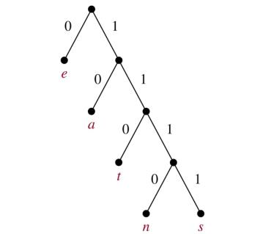
A prefix code can be represented using a binary tree.
character: the label of the leaf edge label: left child → 0, right child → 1
The bit string used to encode a character is the sequence of labels of the edges in the unique path from the root to the leaf that has this character as its label.
Example:
Walking from the root to the leaf repeatedly
encode
e : 0 a : 10 t : 110 n : 1110 s : 1111
decode
11111011100
s
a
n
e
⇒ sane

Slide 55
Huffman Coding (data compression)
Input the frequencies of symbols in a string and output a prefix code that encodes the string using the fewest possible bits, among all possible binary prefix codes for these symbols.
Start with a lot of isolated points and label is the symbol,
Use at least two symbol into a subtree,
Repeat this concept
Using at least two of the subtrees into a subtree, ...

Slide 56
Algorithm 2 (Huffman Coding)
Procedure Huffman(C: symbols a_{i} with frequencies w_{i}, i = 1, …, n)
F := forest of n rooted trees, each consisting of the single vertex a_{i} and assigned weighted w_{i}
while F is not a tree
begin
Replace the rooted trees T and T’ of least weights from F with w(T) ≥ w(T’) with a tree having a new root that has T as its left subtree and T’ as its right subtree. Label the new edge to T with 0 and the new edge to T’ with 1.
Assign w(T)+w(T’) as the weight of the new tree.
end

Slide 57
Example 5 Use Huffman coding to encode the following symbols with the frequencies listed: A: 0.08, B: 0.10, C: 0.12, D: 0.15, E: 0.20, F: 0.35. What is the average number of bits used to encode a character?
Sol: 1. Next map
2. The average number of bits is:
Each symbol total length × frequency = 3×0.08+ 3×0.10+ 3×0.12+ 3×0.15+2×0.20+2×0.35 =2.45

Slide 58
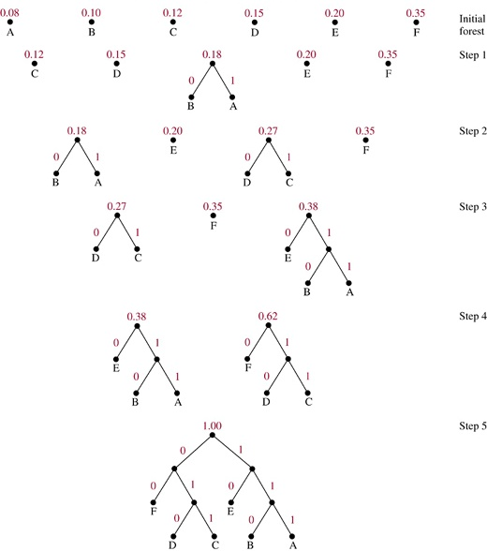

Slide 59
Tree Traversal
We need procedures for visiting each vertex of an ordered rooted tree to access data.
Universal Address Systems
Label vertices:
root → 0, its k children → 1, 2, …, k (from left to right)
For each vertex v at level n with label A, its r children → A.1, A.2, …, A.r (from left to right).
We can totally order the vertices using the lexicographic ordering of their labels in the universal address system.
x₁.x₂…..x_{n} < y₁.y₂…..y_{m} if there is an i, 0 ≤ i ≤ n, with x₁=y₁, x₂=y₂, …, x_{i-1}=y_{i-1}, and x_{i}<y_{i}; or if n<m and x_{i}=y_{i} for i=1, 2, …, n.

Slide 60
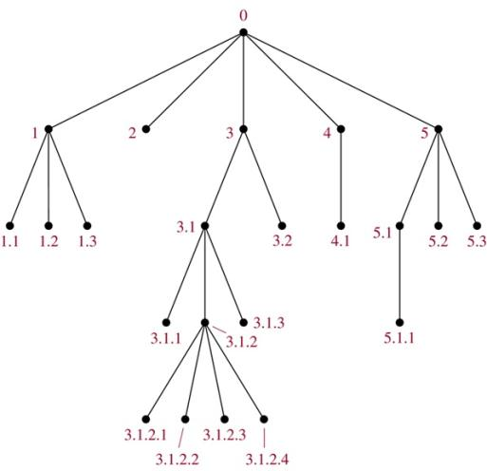
Example 1
The lexicographic ordering is: 0 < 1<1.1 < 1.2 < 1.3 < 2 < 3 < 3.1 < 3.1.1 < 3.1.2 < 3.1.2.1 < 3.1.2.2 < 3.1.2.3 < 3.1.2.4 < 3.1.3 < 3.2 < 4 < 4.1 < 5 < 5.1 < 5.1.1 < 5.2 < 5.3

Slide 61
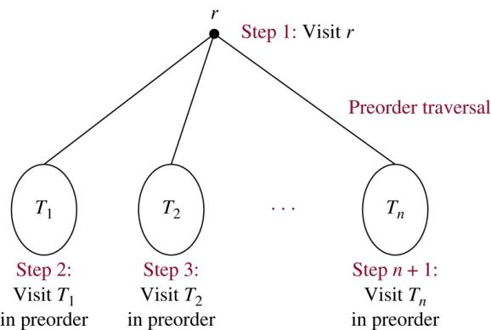
Traversal Algorithms
Preorder traversal (Preorder)

Slide 62
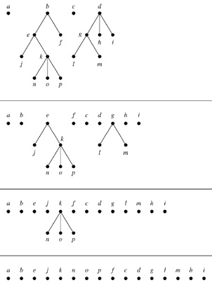
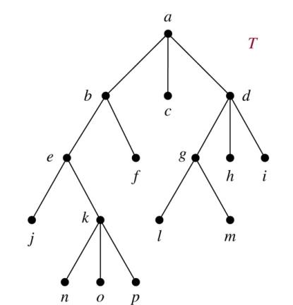
Example 2. In which order does a preorder traversal visit the vertices in the ordered rooted tree T shown below?
Sol:

Slide 63
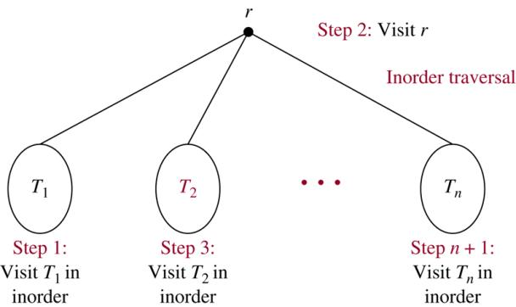
Inorder traversal(In the sequence)

Slide 64
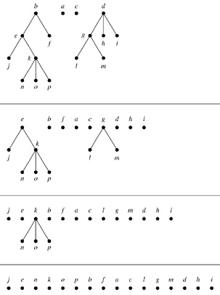
Example 3. In which order does a preorder traversal visit the vertices in the ordered rooted tree T shown below?
Sol:

Slide 65
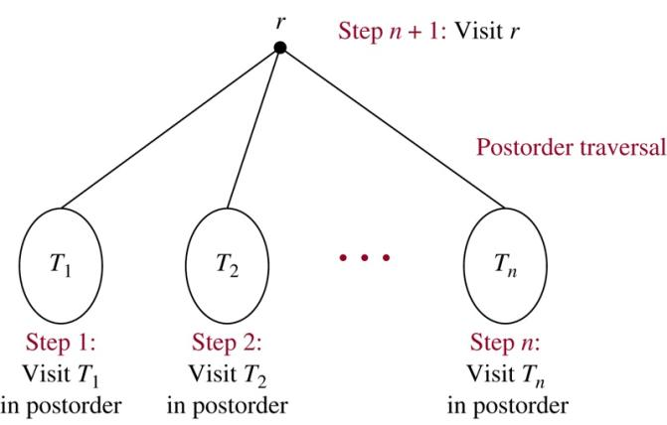
Postorder traversal

Slide 66
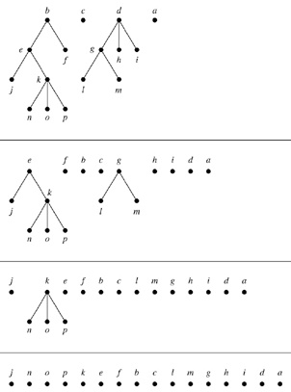
Example 4. In which order does a preorder traversal visit the vertices in the ordered rooted tree T shown below?
Sol:

Slide 67
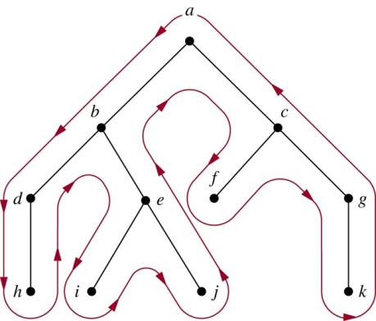
Easy representation: draw a red line around the ordered rooted tree
starting at the root, moving along the edges
Preorder: listing each vertex the first time this line passes it
Inorder: listing a leaf the first time the line passes it and listing
each internal vertex the second time the line passes it
Postorder: listing a vertex the last time it is passed on the way back up
to its parent
Preorder: a, b, d, h, e, i, j, c, f, g, k
Inorder: h, d, b, i, e, j, a, f, c, k, g
Postorder: h, d, i, j, e, b, f, k, g, c, a

Slide 68
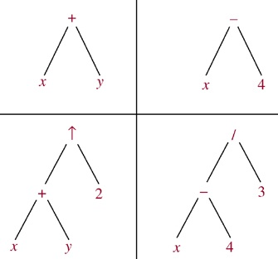
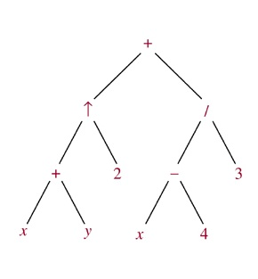
Infix, Prefix, and Postfix Notation
We can represent complicated expressions, such as compound propositions, combinations of sets, and arithmetic expressions using ordered rooted trees.
Example 1 Find the ordered rooted tree for ((x+y)↑2)+((x−4)/3).
Sol.
leaf: variable internal vertex: operation on its left and right subtrees

Slide 69
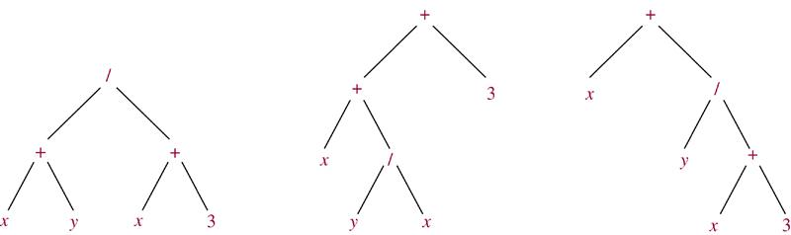
The following binary trees represent the expressions: (x+y)/(x+3), (x+(y/x))+3, x+(y/(x+3)). All their inorder traversals lead to x+y/x+3 ⇒ ambiguous ⇒ need parentheses
Infix form: An expression obtained when we traverse its rooted tree with inorder. Prefix form: … … by preorder. (also named Polish notation) Postfix form: … … by postorder. (reverse Polish notation)

Slide 70
Example 6 What is the prefix form for ((x+y)↑2)+((x−4)/3)?
Sol.
+ ↑ + x y 2 / − x 4 3
Example 8 What is the postfix form of the expression ((x+y)↑2)+((x−4)/3)?
Sol.
x y + 2 ↑ x 4 − 3 / +
Note. An expression in prefix form or postfix form is unambiguous, so no parentheses are needed.

Slide 71
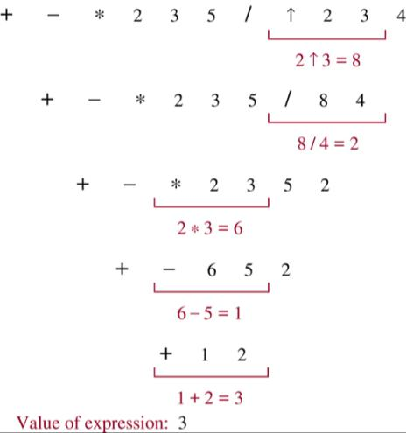
Example 7 What is the value of the prefix expression + − * 2 3 5 / ↑ 2 3 4?
Sol.
Operation from right to left, First sign of operation (For example, ↑) The two figures on the right doing this operation, Results in original place, And so on.

Slide 72
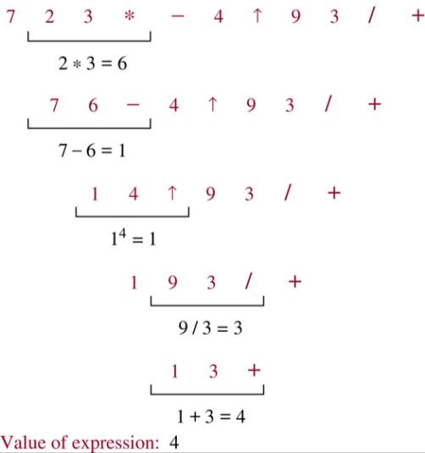
Example 9 What is the value of the postfix expression 7 2 3 * − 4 ↑ 9 3 / +?
Sol.
Operations from left to right, First sign of operation (For example, *) Two numbers on the left of this operation, Result replaces the original location, and so on.

Slide 73
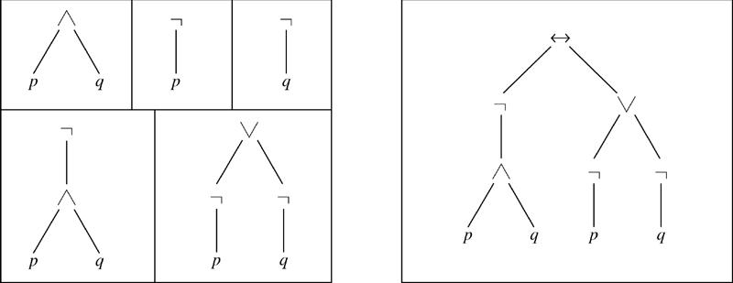
Example 10 Find the ordered rooted tree representing the compound proposition (¬(p∧q)) ↔ (¬p∨¬q). Then use this rooted tree to find the prefix, postfix, and infix forms of this expression.
Sol.
prefix: ↔ ¬ ∧ p q ∨ ¬ p ¬ q
infix: (¬(p∧q)) ↔ ((¬p)∨(¬q))
postfix: p q ∧ ¬ p ¬ q ¬ ∨ ↔

Slide 74
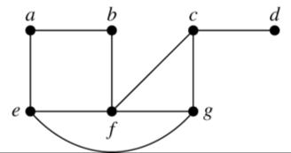
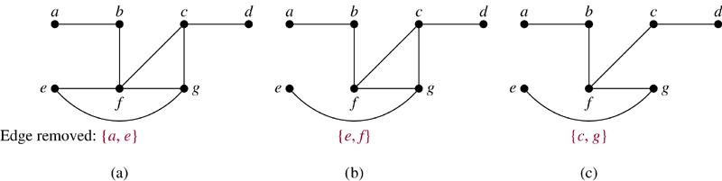
10.4 Spanning Trees
Introduction
Def. Let G be a simple graph. A spanning tree of G is a subgraph of G that is a tree containing every vertex of G.
Example 1 Find a spanning tree of G.
Sol.
Remove an edge from any circuit. (repeat until no circuit exists)

Slide 75
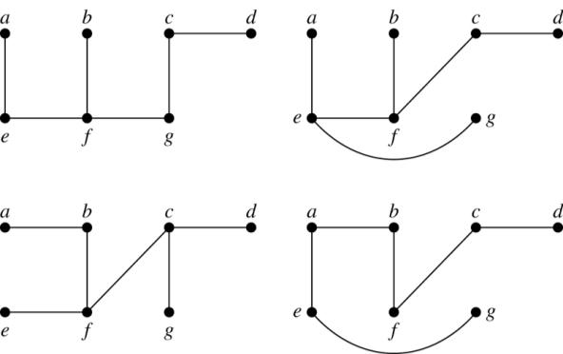
Four spanning trees of G:
Thm 1 A simple graph is connected if and only if it has a spanning tree.

Slide 76
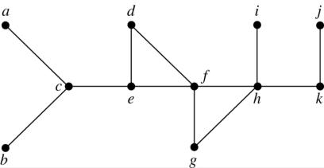
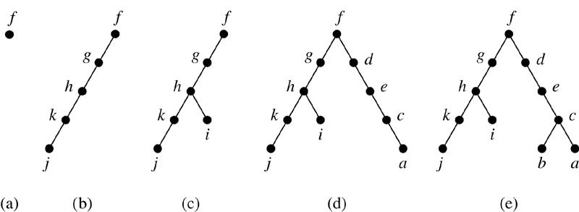
Depth-First Search (DFS)
Example 3 Use depth-first search to find a spanning tree for the graph.
Sol. (arbitrarily start with the vertex f)

Slide 77
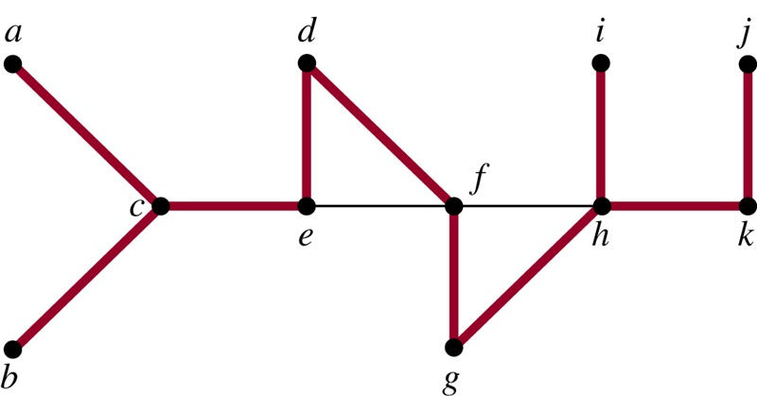
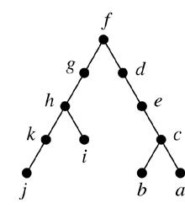
The edges selected by DFS of a graph are called tree edges. All other edges of the graph must connect a vertex to an ancestor or descendant of this vertex in the tree. These edges are called back edges.
Example 4 (Previous question)
⇒
The tree edges (red) and back edges (black)

Slide 78
Algorithm 1 (Depth-First Search)
Procedure DFS(G: connected graph with vertices v₁, v₂, …, v_{n})
T := tree consisting only of the vertex v₁
visit(v₁)
procedure visit(v: vertex of G)
for each vertex w adjacent to v and not yet in T
begin
add vertex w and edge {v, w} to T
visit(w)
end

Slide 79
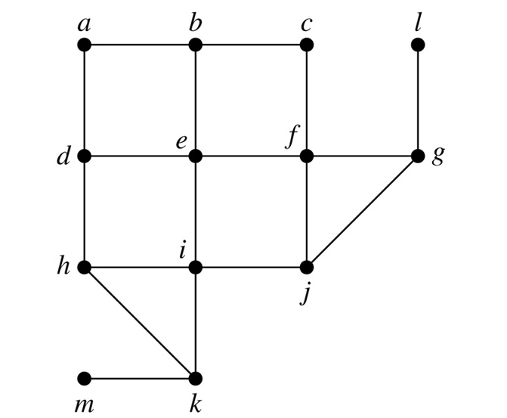
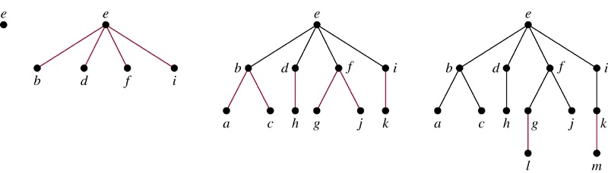
Breadth-First Search (BFS)
Example 5 Use breadth-first search to find a spanning tree for the graph.
Sol. (arbitrarily start with the vertex e)

Slide 80
Algorithm 2 (Breadth-First Search)
Procedure BFS(G: connected graph with vertices v₁, v₂, …, v_{n})
T := tree consisting only of vertex v₁
L := empty list
put v₁ in the list L of unprocessed vertices
while L is not empty
begin
remove the first vertex v from L
for each neighbor w of v
if w is not in L and not in T then
begin
add w to the end of the list L
add w and edge {v, w} to T
end
end

Slide 81
Backtracking Applications
There are problems that can be solved only by performing an exhaustive (Complete) search of all possible solutions.
Decision tree: each internal vertex represents a decision, and each leaf is a possible solution.
To find a solution via backtracking: On the decision tree from
the root to do a series of decision to the leaf, If the leaf is not
the solution, or the entire subtree check solution is not found,
Back to the top parent instead of looking for another tree.

Slide 82
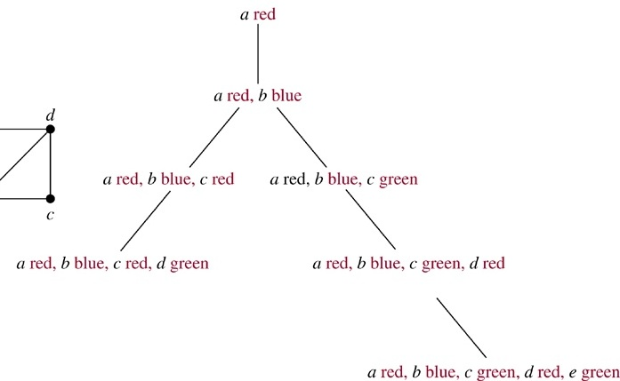
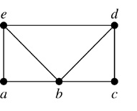
Example 6 (Graph Colorings) How can backtracking be used to decide whether the following graph can be colored using 3 colors?
Sol.

Slide 83
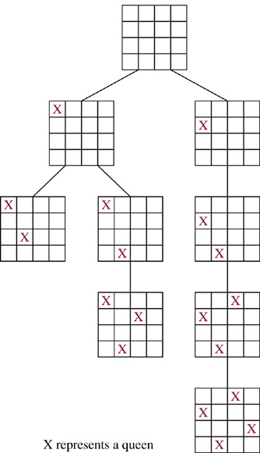
Example 7 (The n-Queens Problem) The n-queens problem asks how n queens can be placed on an n×n chessboard so that no two queens can attack on another. How can backtracking be used to solve the n-queens problem.
Sol.
A case study of n=4
3rd column

Slide 84
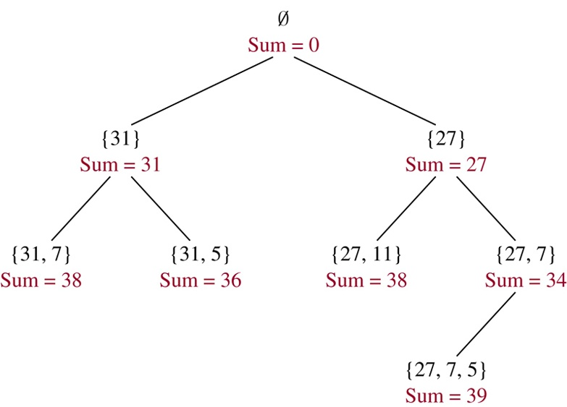
Example 8 (Sum of Subsets) Give a set S of positive integers x₁, x₂, …, x_{n}, find a subset of S that has M as its sum. How can backtracking be used to solve this problem.
Sol.
S = {31, 27, 15, 11, 7, 5} M = 39

Slide 85
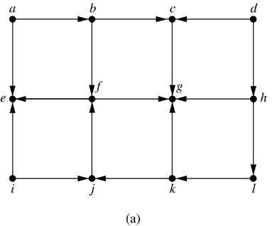

Depth-First Search in Directed Graphs
Example 9 What is the output of DFS given the graph G?
Sol.

Slide 86
Thank You

